Slide 1


Airbnb San Francisco

Slide 2

Business Use
use machine learning libraries and tools to analyze the parameters that determine the value and price of a unit so renters aren’t listing units blindly
Based on the amenities in your property, how much should you charge for you rental?
which categories have the most influence on the price of a rental?

Slide 3
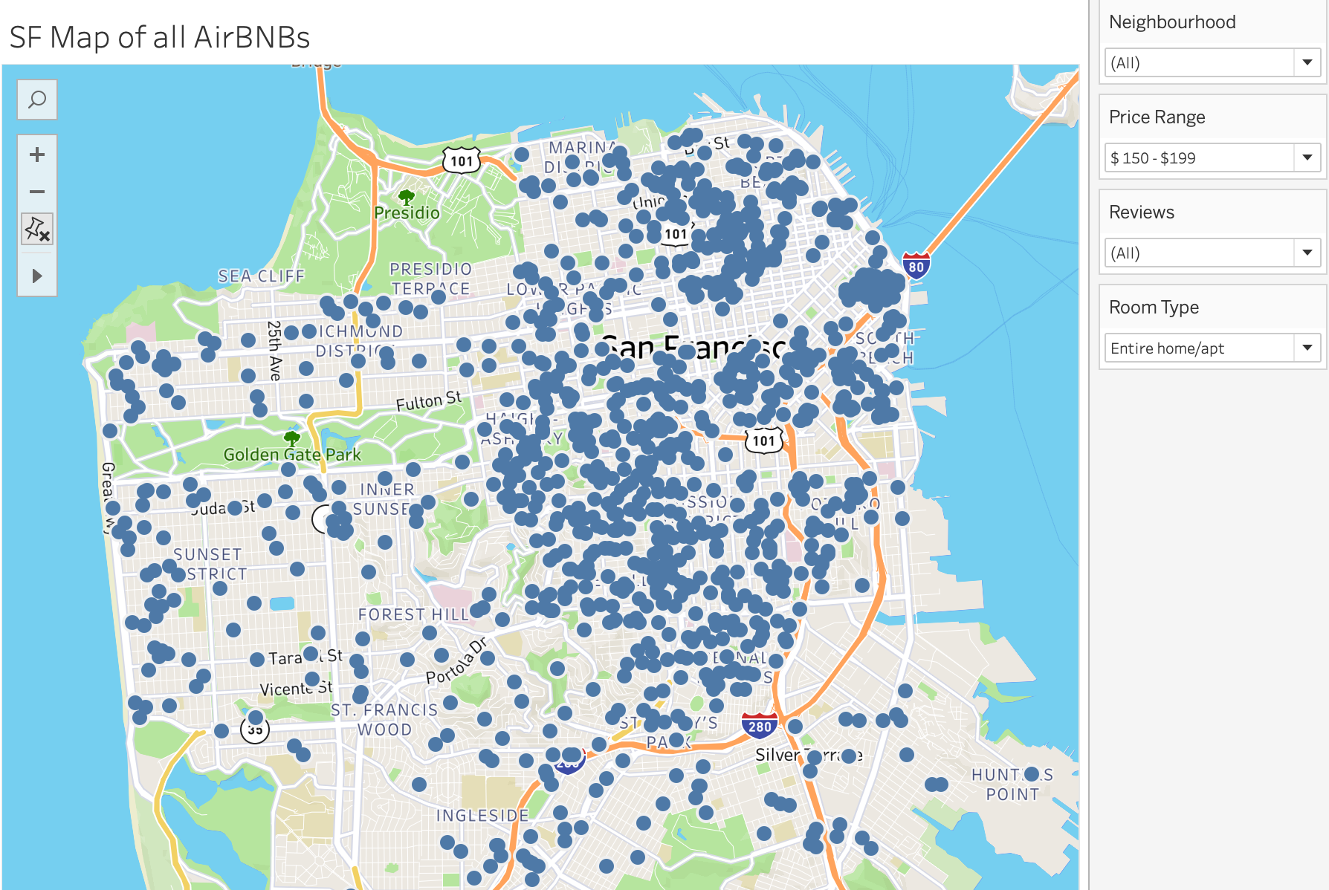
Tableau Visualization and Analysis
Tableau was used to get a broader sense of what was included in the dataset
Latitude and longitude were used to map each of the properties - price, description, and various other variables were in included in the visualizations
When using machine learning codes, Tableau was used as a reference to cross check the model

Slide 4
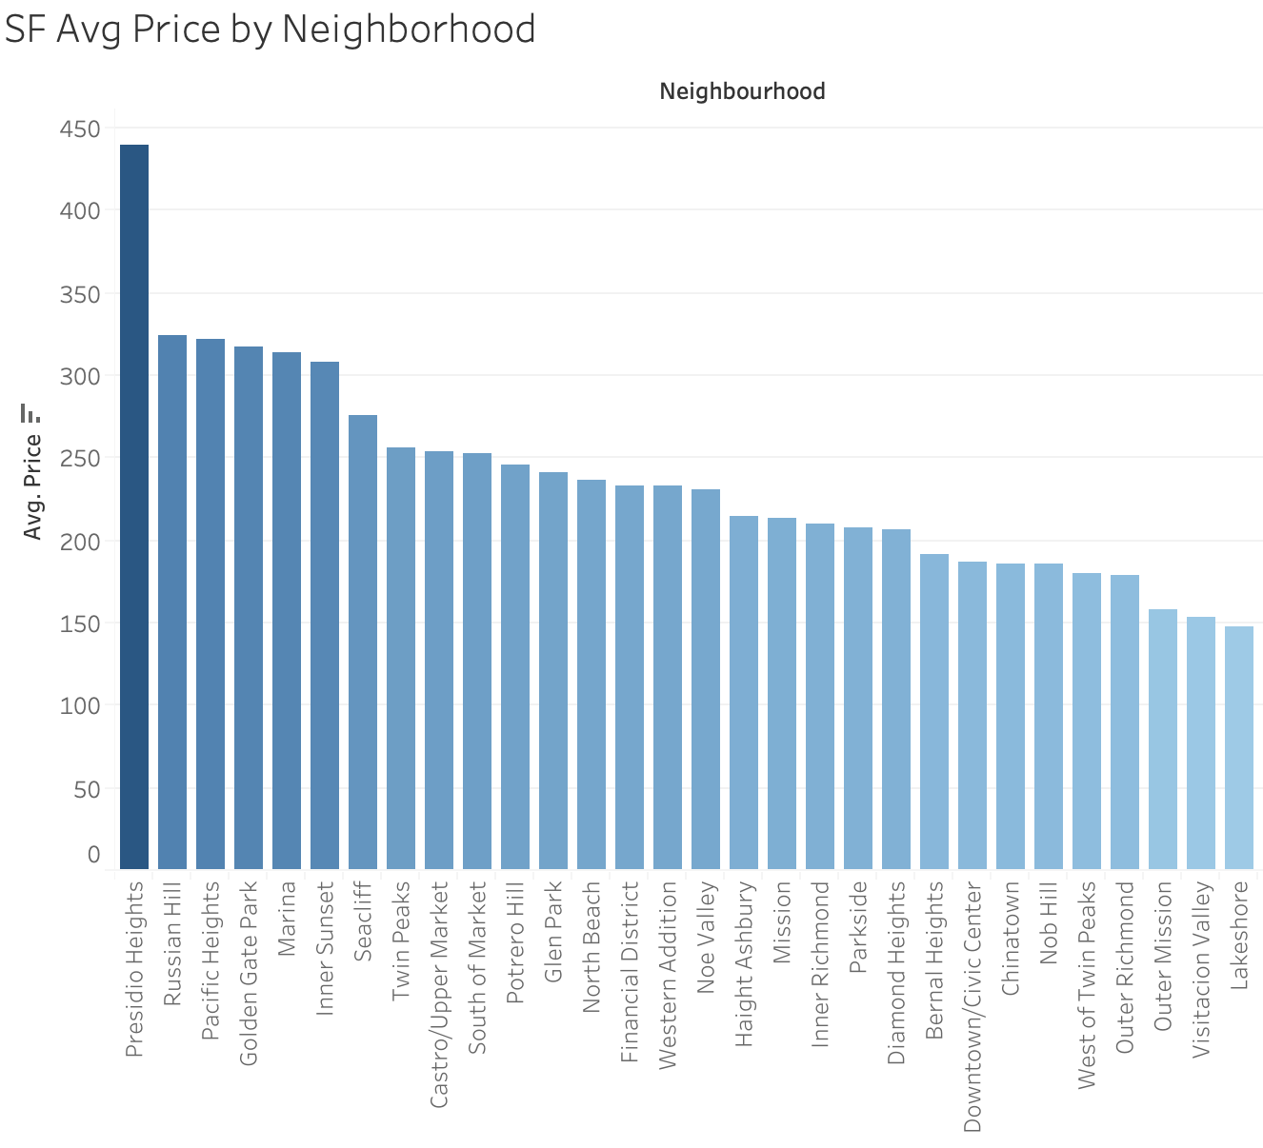
Tableau Visualization and Analysis
the average price of each neighborhood in San Francisco was found to identify the most expensive areas in the city
sets were created that allow users to filter properties by price range and number of reviews
Presidio heights, due to the proximity of the Golden Gate Bridge and the type of listings available was the most expensive neighborhood in San Francisco

Slide 5
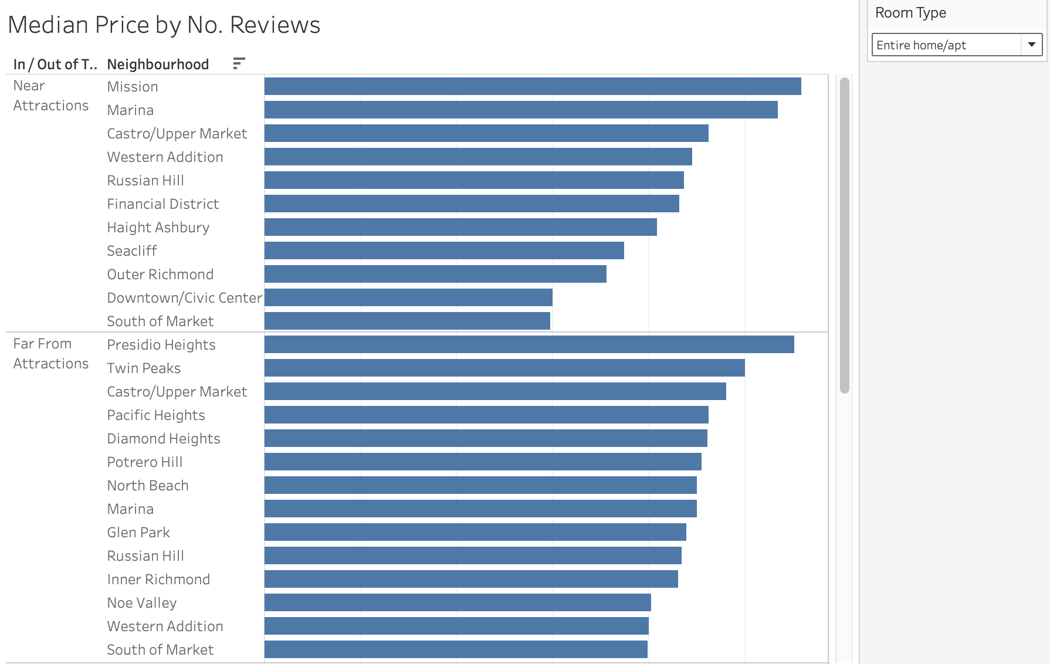
Tableau Visualization and Analysis
Sets were created to identify properties that were within a .25 mile radius of the most popular tourist attractions in San Francisco
a median price was for each neighborhood and a filter was added that allows the user to view the median price of each room type
Sites included:
The Painted Ladies
The Golden Gate Bridge
Dolores Park
SF MOMA
Land’s End

Slide 6
Libraries used
GeoPandas is an open source project to make working with geospatial data in python easier. GeoPandas extends the datatypes used by pandas to allow spatial operations on geometric types.
XGboost is a ML library that implements gradient boosting decision tree algorithm.
Pandas
Sklearn
Numpy
matplot
Tableau
Geopandas
XGboost

Slide 7
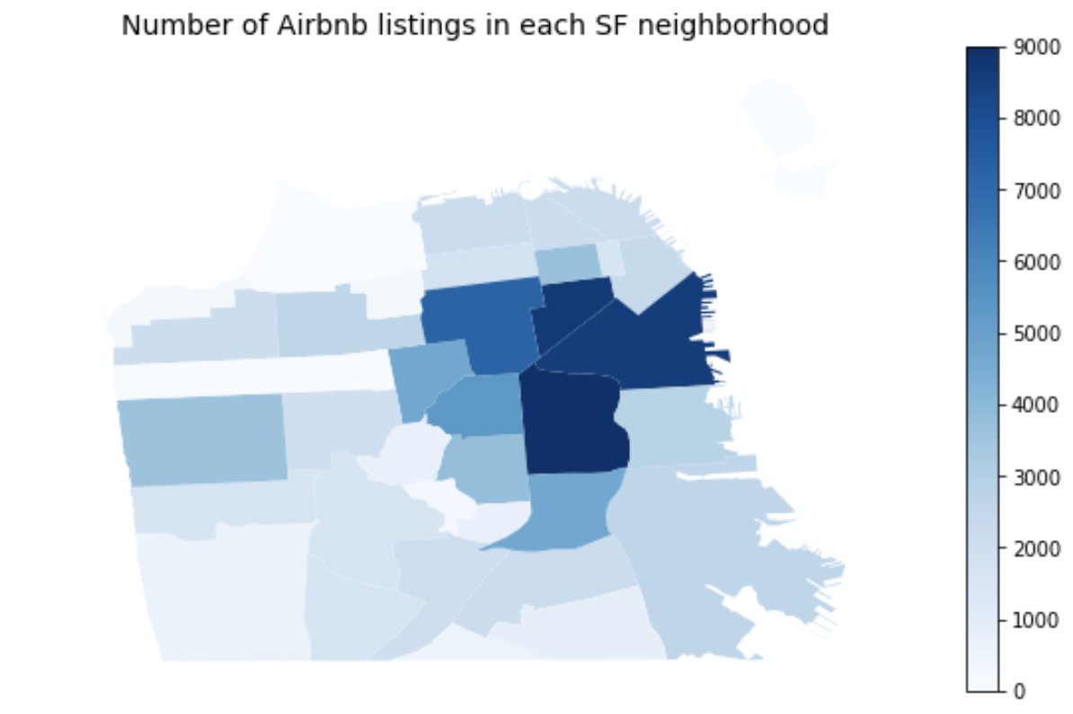
Machine Learning Visualization and Analysis
Top Neighborhoods
Mission District
SOMA
Financial District
Castro
Hayes Valley
Twin Peaks

Slide 8
Machine Learning Visualization and Analysis
XGBoost results:
Training MSE: .1108
Validation MSE: .1297
Training R2: .7716
Validation R2: .7252
Linear Regression:
Training Score: .6391
Testing Score: .6384
Lasso:
MSE: .1791
R2: .6204

Slide 9
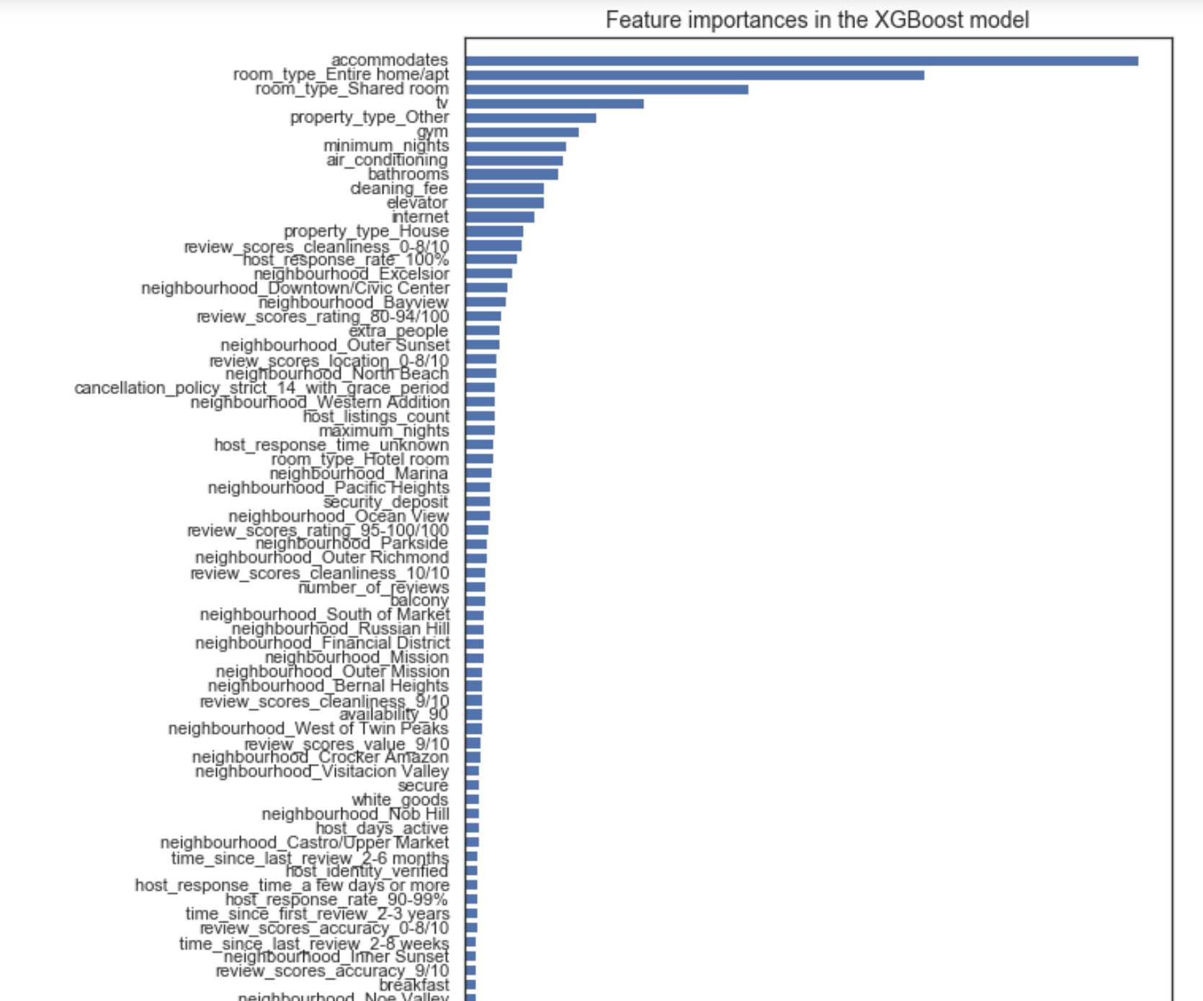
Top Features:
Number of people a unit can accommodate
Entire Apt
Shared Room
TV
Gym
Min. Nights
AC
Bathrooms

Slide 10
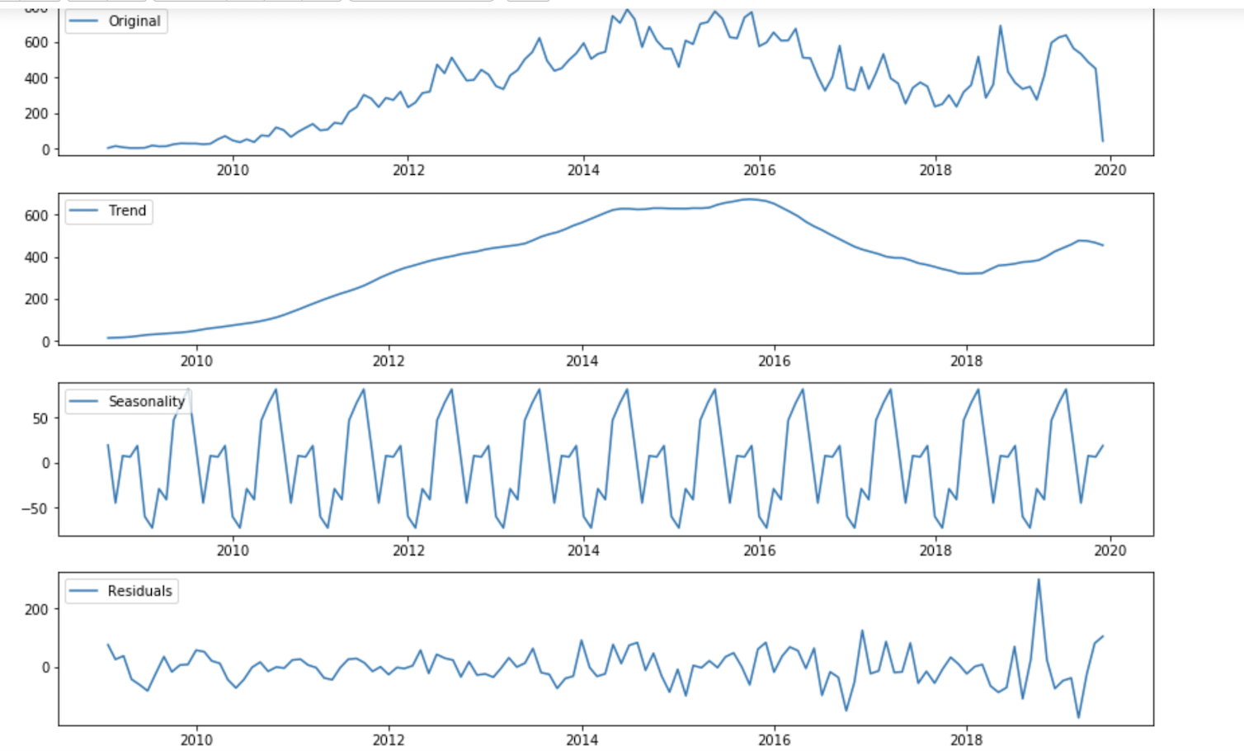
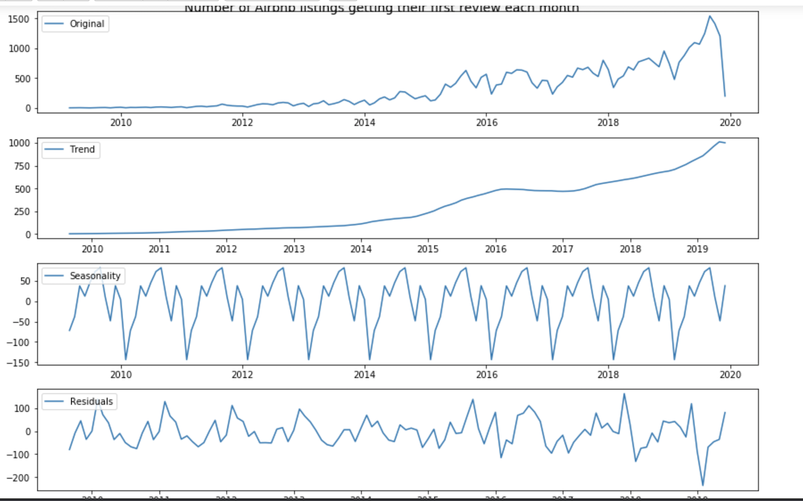
Machine Learning Visualization and Analysis
Number of hosts joining the Airbnb each month/Number of listings getting their first review
Visualization of the number of AirBnb listings getting their first review each month
Peaks in the middle of the summer and lowest points at the beginning and end of each year.
Peak year 2015 emerged as Airbnb’s largest year in terms of users with 25k active hosts

Slide 11

Conclusion
Time (seasonality), location, and description of a listing determine the price of a listing
Machine Learning isn’t a magical black box. How “smart” your data is has a much larger effect than we had expected.
Example: binning reviews and manipulating zeroes for numerical values at the end of our data cleaning process.

Slide 12

Phase 2?
Test the model on other cities to determine consistency.
Produce an HTML based form that would walk a new host through the pricing process.
Incorporate NLP to test the effect/influence of BNB descriptions.

Slide 13

Questions

